Slide 1
Advanced Cypress Features
Date: 26th Feb 2026
Duration: 2 hours
Presenter: Vishnu Shankar

Slide 2
Agenda
1. API Testing Using Cypress
2. Using cy.request()
3. Handling Iframes in Tests
4. File Uploads and Downloads
5. Fixtures & Test Data Management
6. Mocking Network Requests, Environment Variables

Slide 3
API Testing Using Cypress
Cypress allows for efficient testing of APIs directly within your test scenarios.
Native support for HTTP methods provides simple yet powerful ways for validating APIs.
Assertions can be applied to check response status, headers, and body content seamlessly.
Faster, cleaner, and more reliable than UI-only testing.

Slide 4

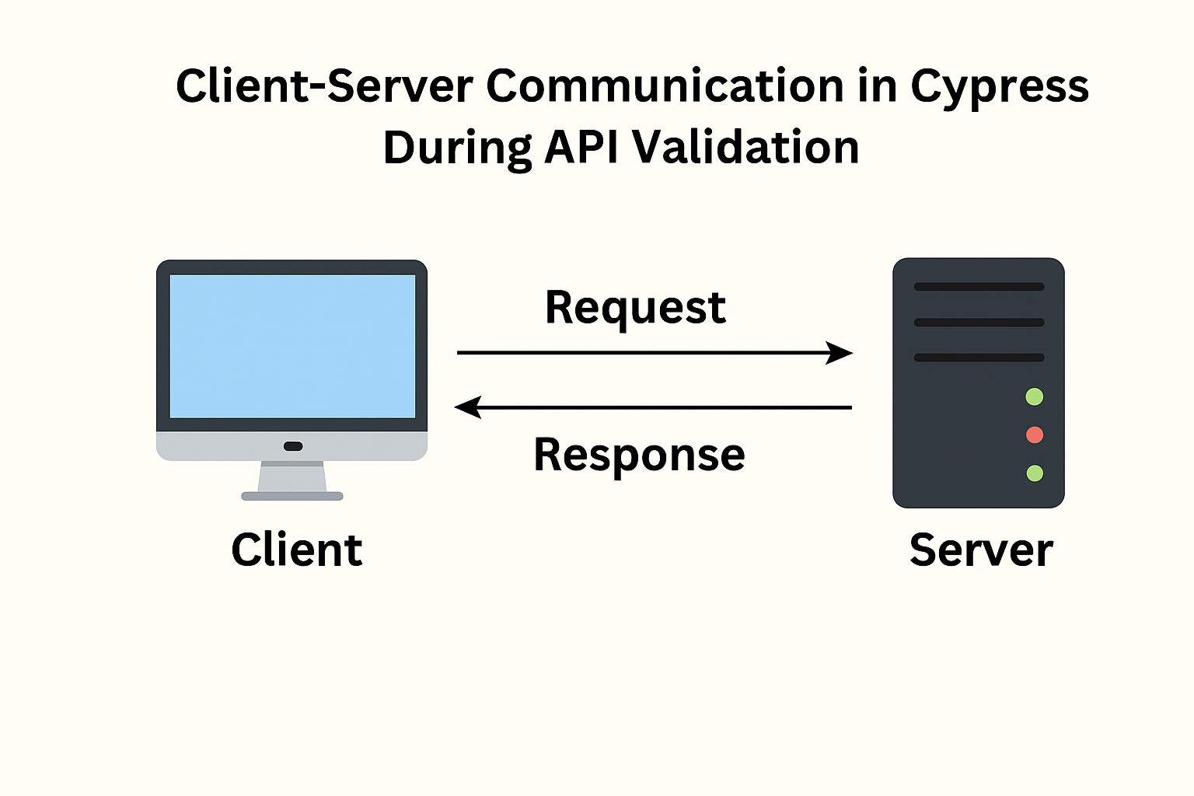
Using cy.request()
cy.request() is a method Used for sending HTTP API requests directly inside Cypress tests.
Supports GET, POST, PUT, DELETE, and more.
Enables assertions on response status, headers, and body.
Ideal for full API testing or setting up data for UI tests

Slide 5
Handling Iframes in Tests
Iframes are tricky due to their embedded nature; Cypress has specific commands for handling them.
Techniques involve accessing iframe content and performing interactions within it.
Ensures tests can simulate user interactions accurately across iframe-based elements.
Iframes load separate documents, so Cypress cannot access them directly
Requires extracting iframe content and wrapping it back into Cypress
Allows typing, clicking, and validating elements inside iframe UI
Ensures accurate simulation of real user interactions on embedded components

Slide 6
File Uploads and Downloads
Cypress supports triggering file uploads and validating downloads in automated tests.
The file-related setup includes using fixtures or programmatically creating test files.
Assertions can verify file presence, content type, and download functionality.
Uploads typically use fixtures or generated test files
Downloads can be validated for existence, content type, and file contents
Ideal for testing import/export, reporting, and document-heavy scenarios

Slide 7
Fixtures & Test Data Management
Fixtures store reusable test data for consistent, maintainable tests
Stored as JSON files, fixtures help organize data outside test files conveniently.
Supports dynamic data injections for complex scenarios or API responses.
Stored as JSON or other static files under cypress/fixtures/
Support dynamic modifications for flexible, complex scenarios
Ideal for both UI and API tests

Slide 8
Mocking Network Requests
Using cy.intercept() for mocking HTTP requests in Cypress is common practice.
Supports stubbing and intercepting network calls for predictable test behavior.
Provides a way to test error scenarios or specific response/result conditions.

Slide 9
Environment Variables in Cypress
Environment variables allow you to configure test setups flexibly.
Sensitive data (e.g., keys) can be managed securely using variables in cypress.env.json.
Helps control test behavior without changing the test code directly.

Slide 10
Configuration Management Best Practices
Keep configurations centralized for managing multiple test setups effectively.
Use separate configuration files for environments like staging, production, etc.
Encourage standardization to maintain consistency across different environments.

Slide 11
Debugging Techniques
Use Cypress Test Runner's snapshots and command history for clear traceability.
Apply cy.log(), cy.debug(), and cy.pause() for interactive debugging.
Inspect DOM states to understand visual/UI issues.
Measure execution time to identify performance bottlenecks
Combine DevTools + Cypress runner for complete visibility

Slide 12
Hands-on Session: Create an API + UI test case
Participants will build an integrated test case involving both API and UI elements.
Practice concepts learned such as cy.request(), fixtures, and mocks.
Cyclic interactions will be explored (e.g., API data triggering UI tests).

Slide 13
Common Challenges in Advanced Testing
Flaky tests due to unstable APIs, UI timing, and dynamic states.
Increasing execution time as test suites grow
Debugging async and dynamic UI behaviour becomes harder
Fix using mocks, smart waits, stable data, API‑based setup, and Cypress debugging tools

Slide 14
Key Takeaways
Understand and manage advanced Cypress features to achieve efficient workflows.
Apply concepts learned in practical and real-world testing scenarios.
Develop confidence in debugging and resolving complex test issues effectively.

Slide 15
Q&A

